Slide 1
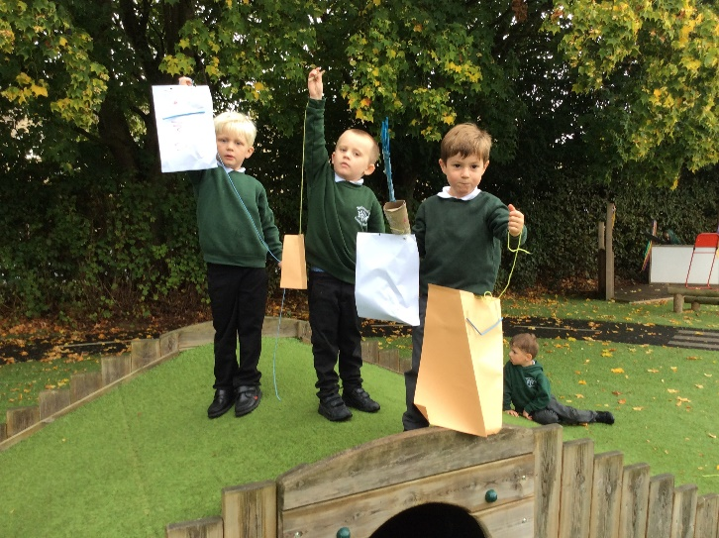
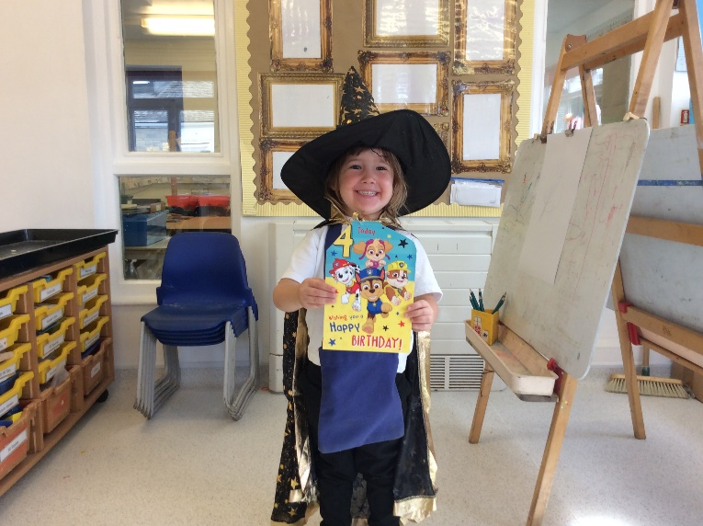
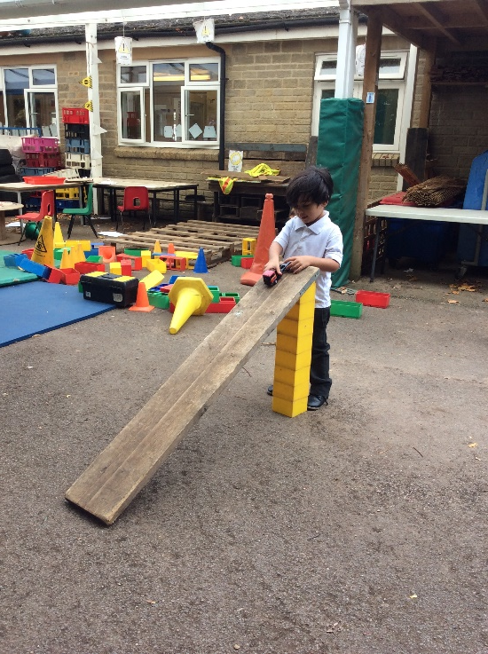
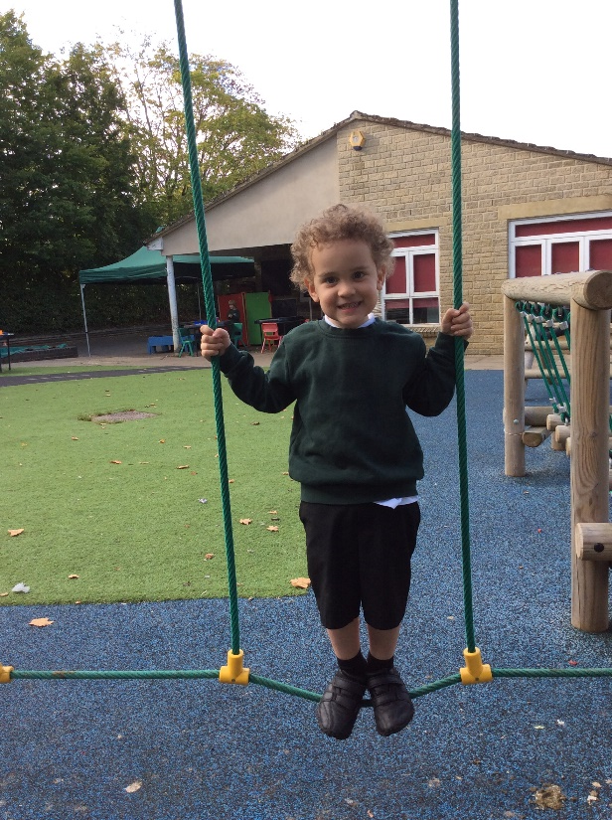
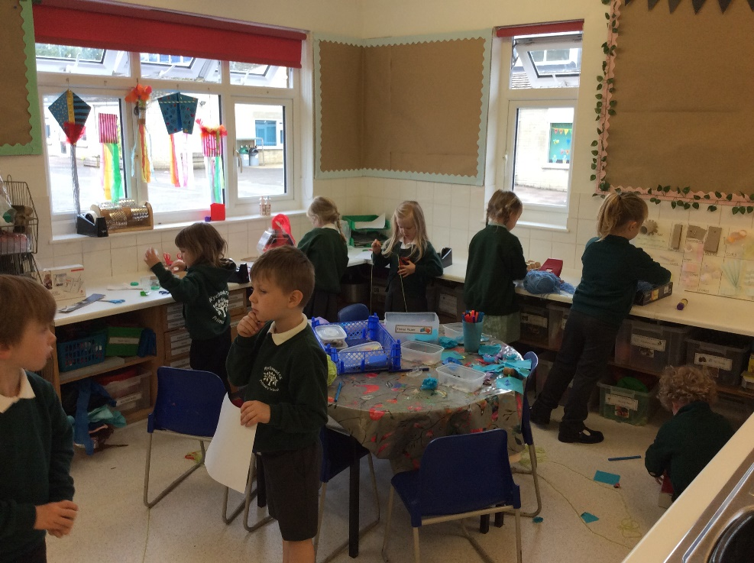
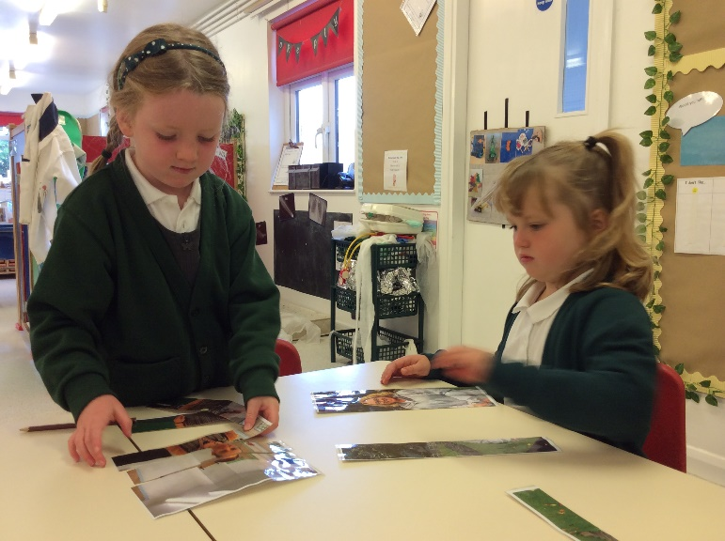
Welcome to Foundation Stage

Slide 2
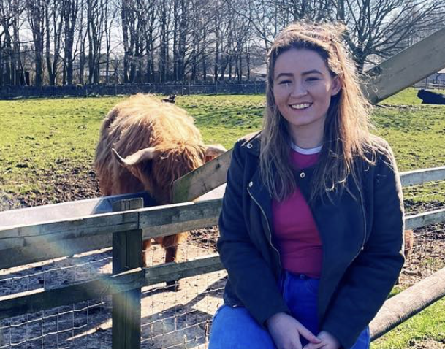
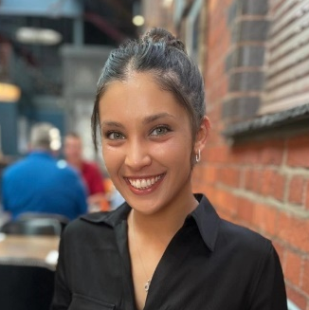
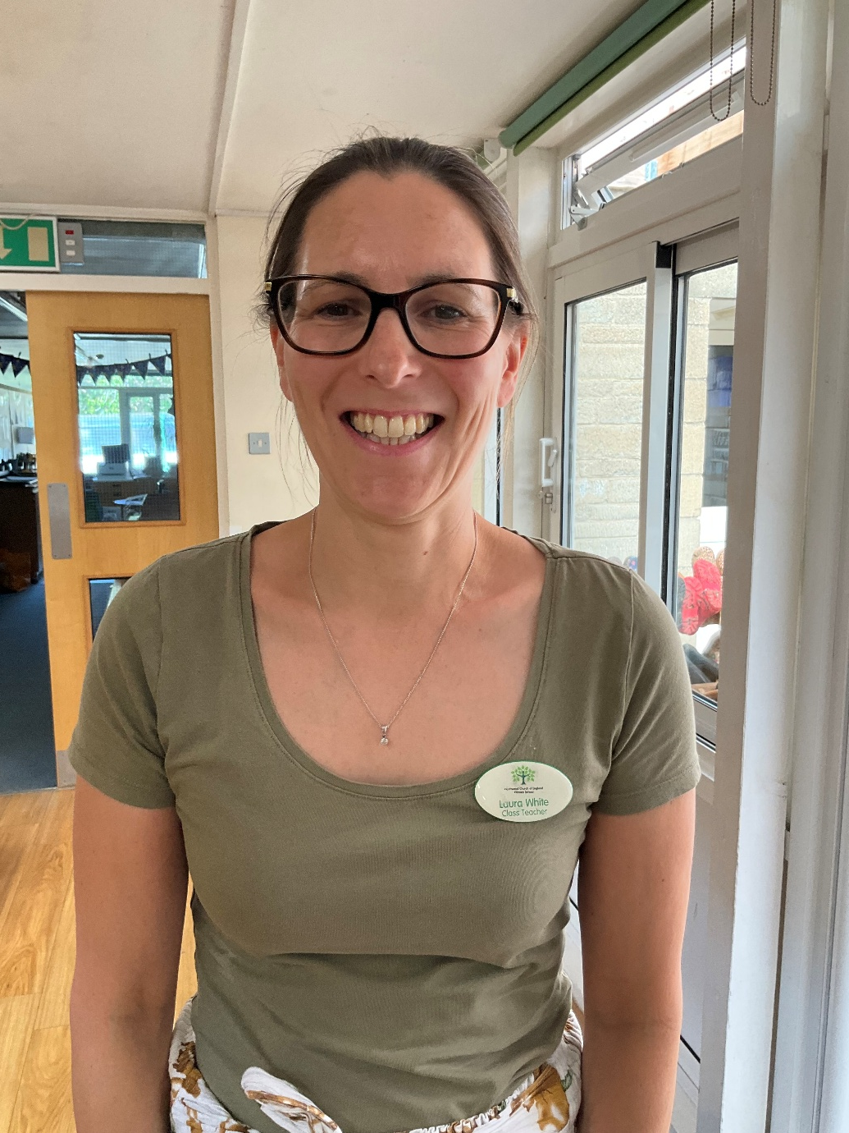
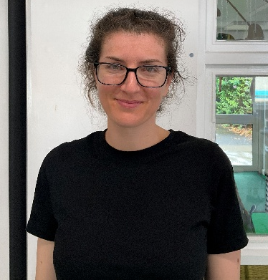
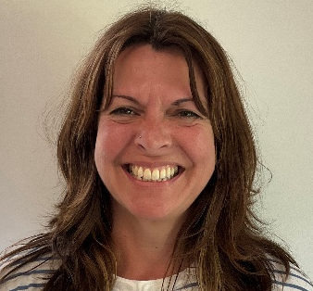
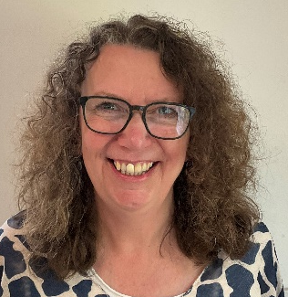
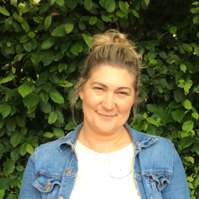

Meet the Foundation Stage Team
Mrs Laura White (EYFS Lead)
Miss Jackson (Hazel Class Teacher)
Miss Rhodes (Ash Class Teacher)
Miss Pavey (TA)
Mrs Edginton (TA)
Mrs Elderfield (TA)
Miss Flynn (TA)
Notes:
Adults consider themselves to be one big team – the TAs work across both classes.
2

Slide 3
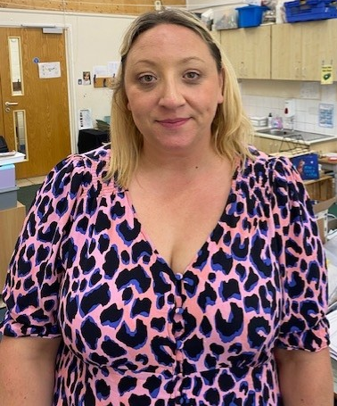
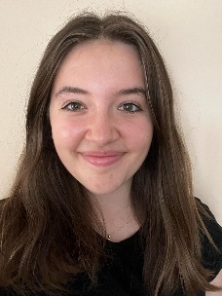
Routine
Mornings consist of daily Literacy, Maths and Phonics sessions.
Two whole class reading lessons a week.
Two vocabulary lessons a week.
One storytelling lesson a week.
Afternoons consist of topic work, reading and Forest School.
Learning through play.
Class teachers out on Wednesday afternoons for PPA (Planning, Preparation and Assessment). Mrs Wheatley to cover in Hazel and Miss Todd to cover is Ash.
Notes:
Morning Activities:
Term 1 and 2 – Dough Disco – to develop finger muscles crucial for writing.
Term 3 and 4 – Doodle Disco – focuses on letter formation
Term 5 and 6 – Sentence Writing

Slide 4
Phonics:
We follow the Read Write Inc scheme.
The children have daily phonics lessons building up to a 30 minute session.
They learn new sounds, consolidate previous sounds, reading words and spend some time reading a book with a partner.
Begin with initial sounds and then learn special friends.
Daily Fred talk.
Green and red words.
See the information pack for more information.
Notes:
Green words- phonetically decodable
Red words- you cannot sound out
Fred talk- explain fred is a frog and only speaks in sounds. Chn need to be successful in fred talk before they able to read. You can help at home by doing fred talk e.g. get in the c-ar. The more they hear the easier it becomes.
Special friends- 2 or more letters that make one sound e.g. ay in play.
You have handout with the different sounds on them that you can use at home.

Slide 5
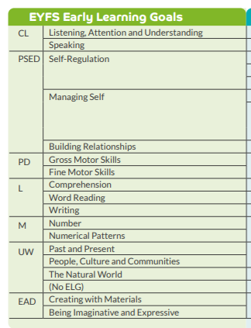
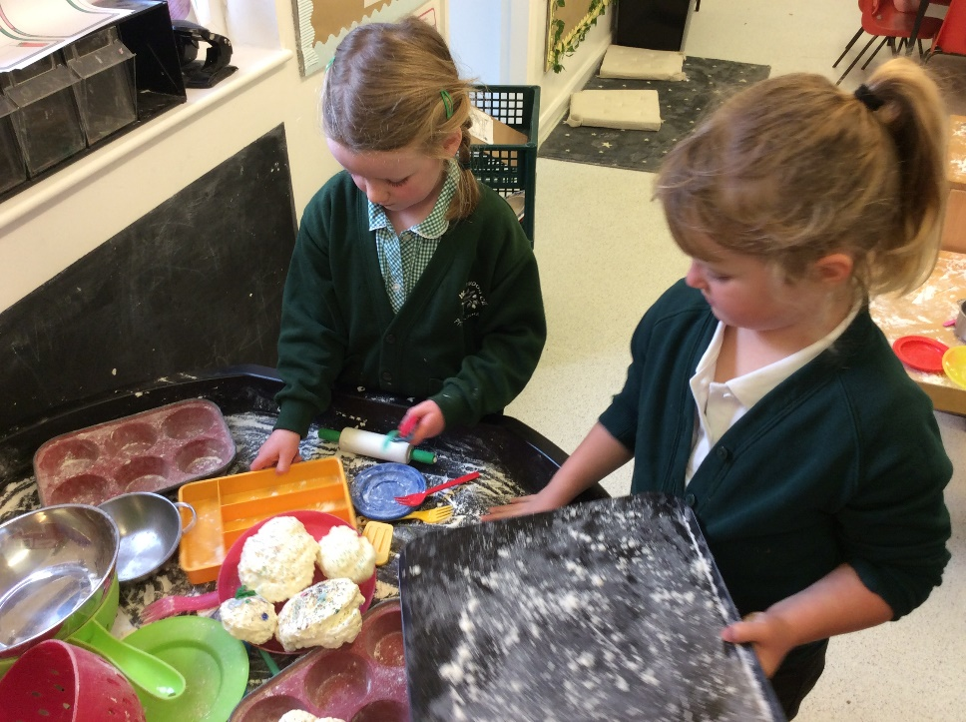
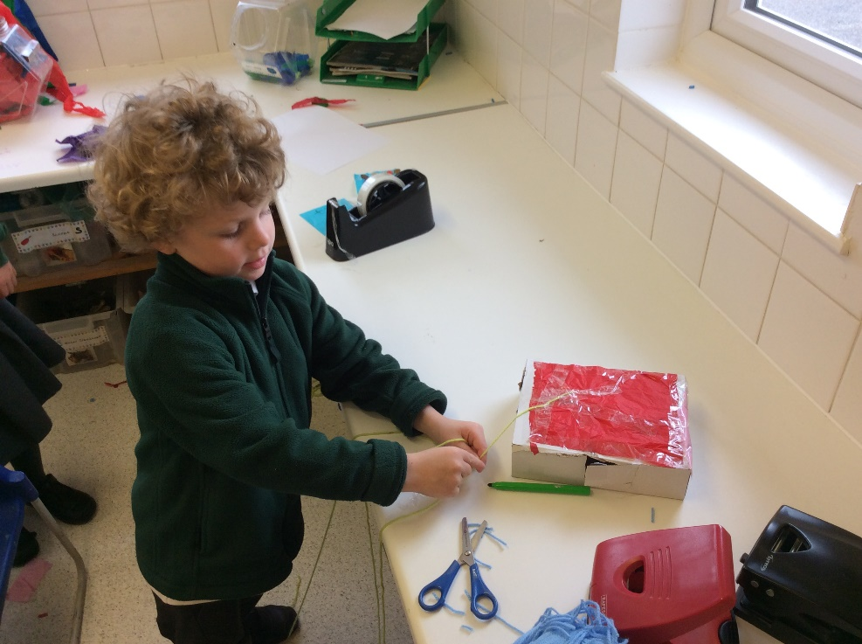
Notes:
CL – Communication and Language
PSED – Personal Social and Emotional Development
PD – Physical Development
L – Literacy
M – Maths
UW – Understanding the World
EAD – Expressive Arts and Design

Slide 6
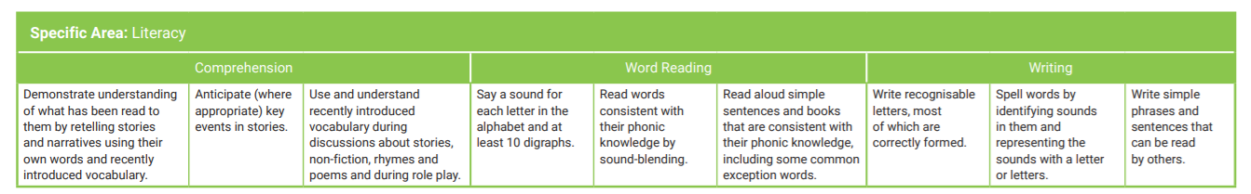
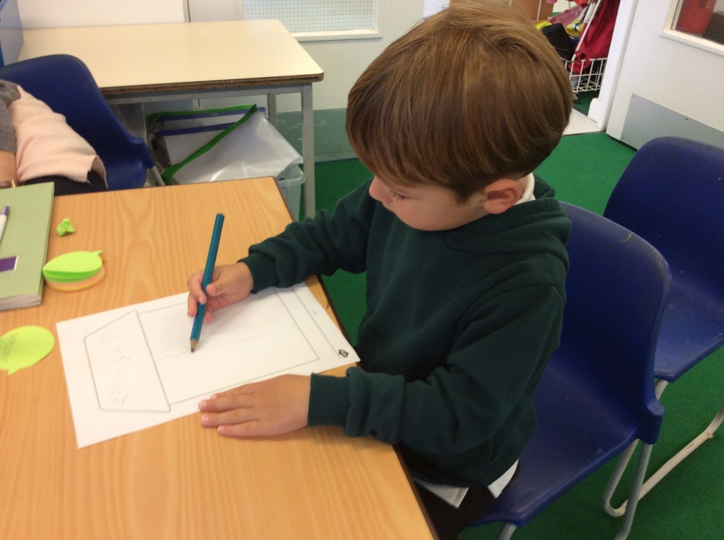
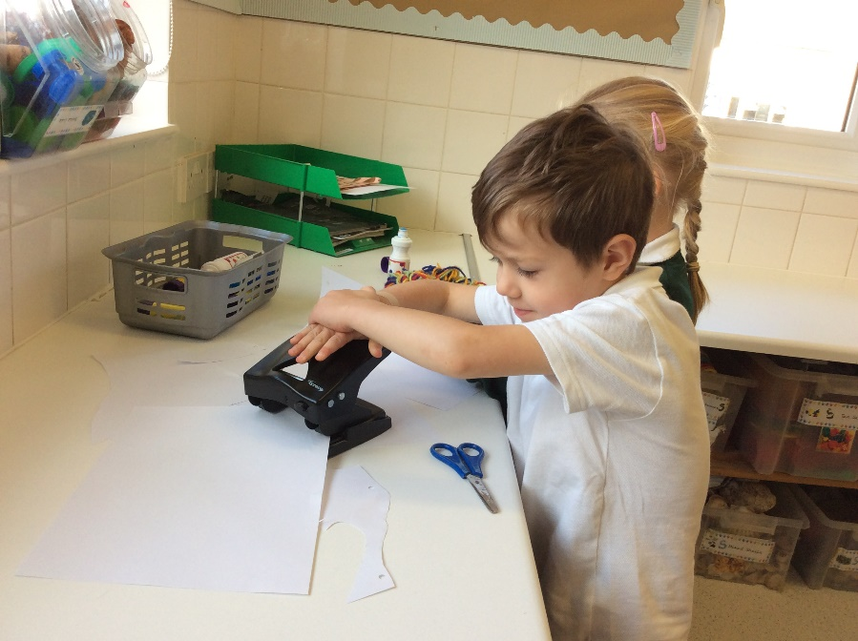
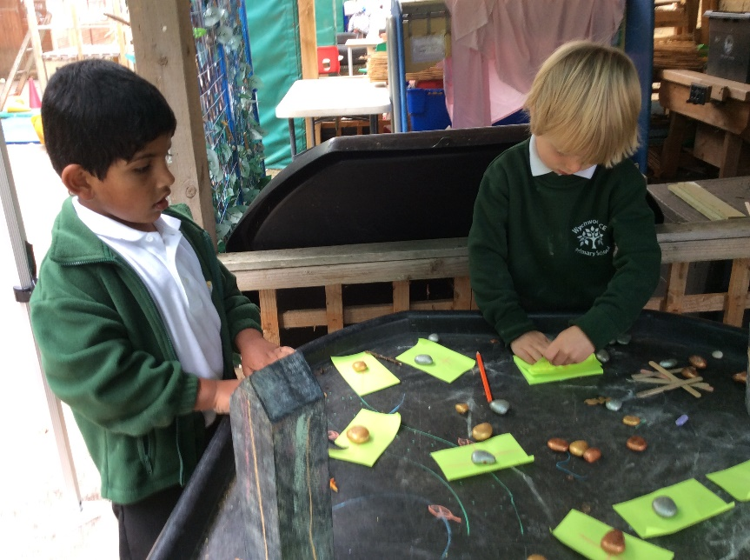
Literacy
Initial and final sounds.
Middle sounds.
Work towards writing a sentence.
Letter formation.
Notes:
We begin by focussing on the initial sound in a word. Once children are able to clearly hear the initial sound, we focus on the final sound in a word e.g. the ‘c’ and ‘t’ in cat. Later we progress to focussing on hearing the middle sound e.g. the ‘a’ in cat.
By the end of the year, children should be writing simple sentences independently e.g. ‘it is hot’.

Slide 7
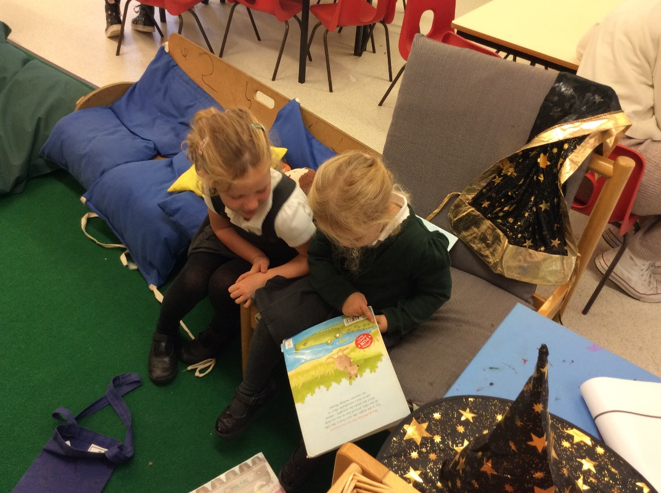
Reading and Books
Children can take a free choice reading book and change this daily from the new lending library.
Children will read weekly with an adult.
Reading daily is encouraged in EYFS to encourage a love of reading and books.
Lending library
See the leaflet for more information.
Notes:
When reading worded books, we expect children to be able to sight read at least 90% of the words in the book before giving them a new book.
Comments about how your child read with an adult will be posted to your child’s seesaw page.

Slide 8
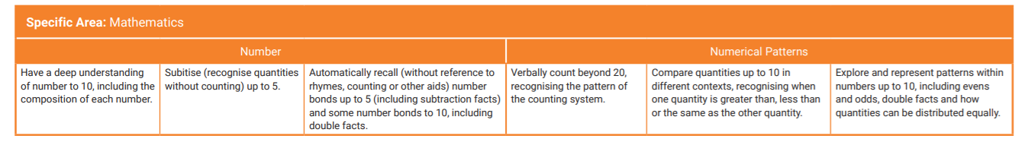
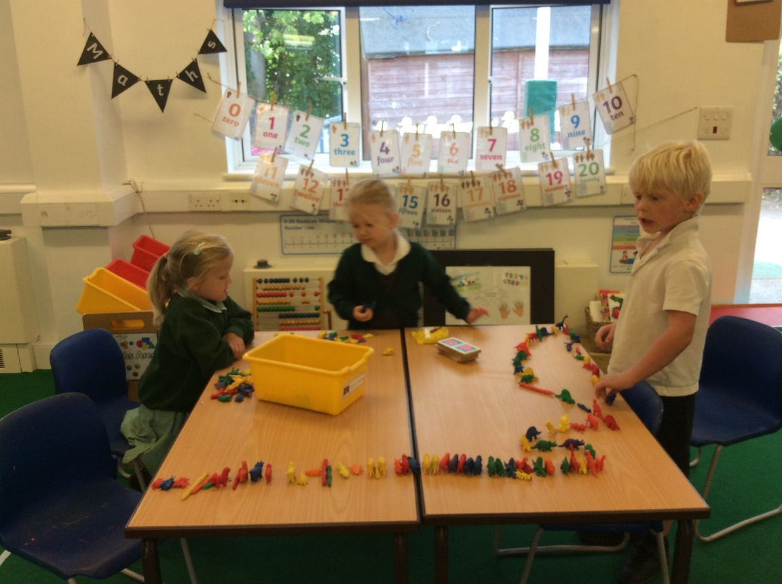
Maths
Daily maths lesson.
Practical and lots of resources.
Whiteboard work.
Mastery approach.
Group work once a week with teacher.
Notes:
We have a practical session using resources within each maths lesson.
We aim to promote children’s reasoning by using I support/I challenge questions- why is it right or wrong?
Numbots

Slide 9
Forest School
Led by Mrs Hoadley
Hazel: Tuesday afternoons
Ash: Friday afternoons
Clothing: waterproof trousers and coat, wellies, jumper
Notes:
Please make sure your child comes to school with these items, wearing their home clothes (that you don’t mind getting muddy!) and we will help them into their waterproofs and wellies.

Slide 10
Snack and Lunch Times
Rolling snack
Snack self-registration
Cup and jugs of water provided
Children are supervised whilst using the self-service register for lunch
Office provide lunch staff with list of children with lunchboxes
Cup and jugs of water provided
Notes:
Children have a self-register to show when they have eaten snack. Adults check this frequently and will remind children who have not had snack to eat a piece of fruit. Snack is available until 10:30am.

Slide 11
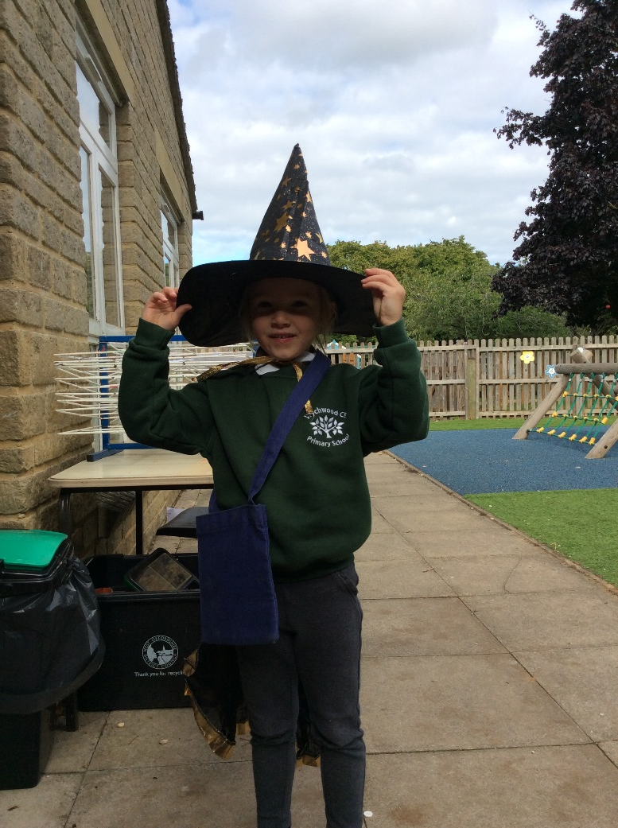
Learner and Writer of the week:
After October half term we will select two children from each class to be our learner and writer of the week.
The learner of the week will take home the literacy or maths buddies.
This is an opportunity for you to foster a love of learning at home with your child.
Word wizard:
This is awarded to children who use our words that are taught as part of our vocabulary session.

Slide 12
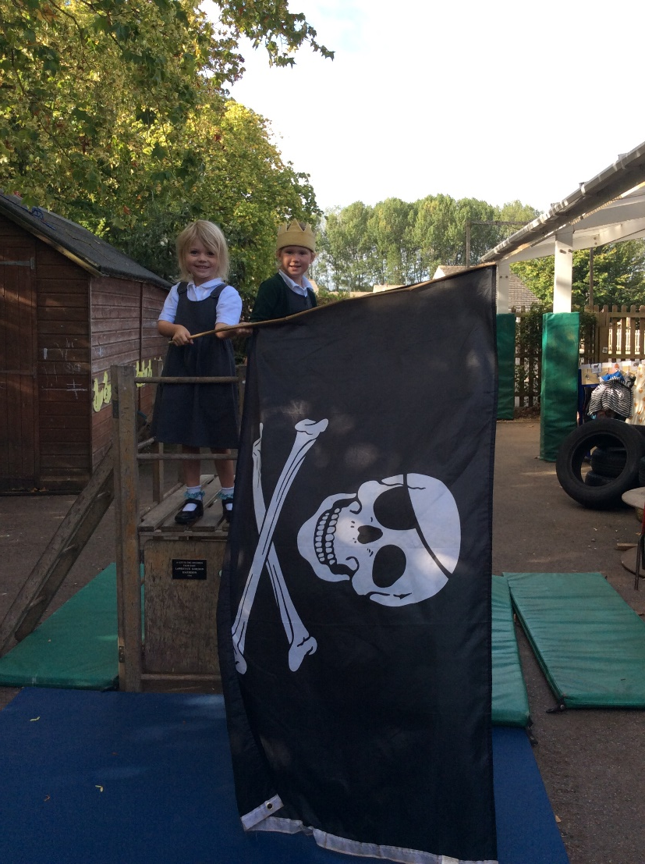
Seesaw
Make sure you have set up your Seesaw account.
Recommended home learning for reception children:
Daily reading (a mixture of being read to and reading phonics books)
Weekly – 2/3 sessions on Numbots.
Notes:
Add in here about permission for photos/videos on Seesaw

Slide 13
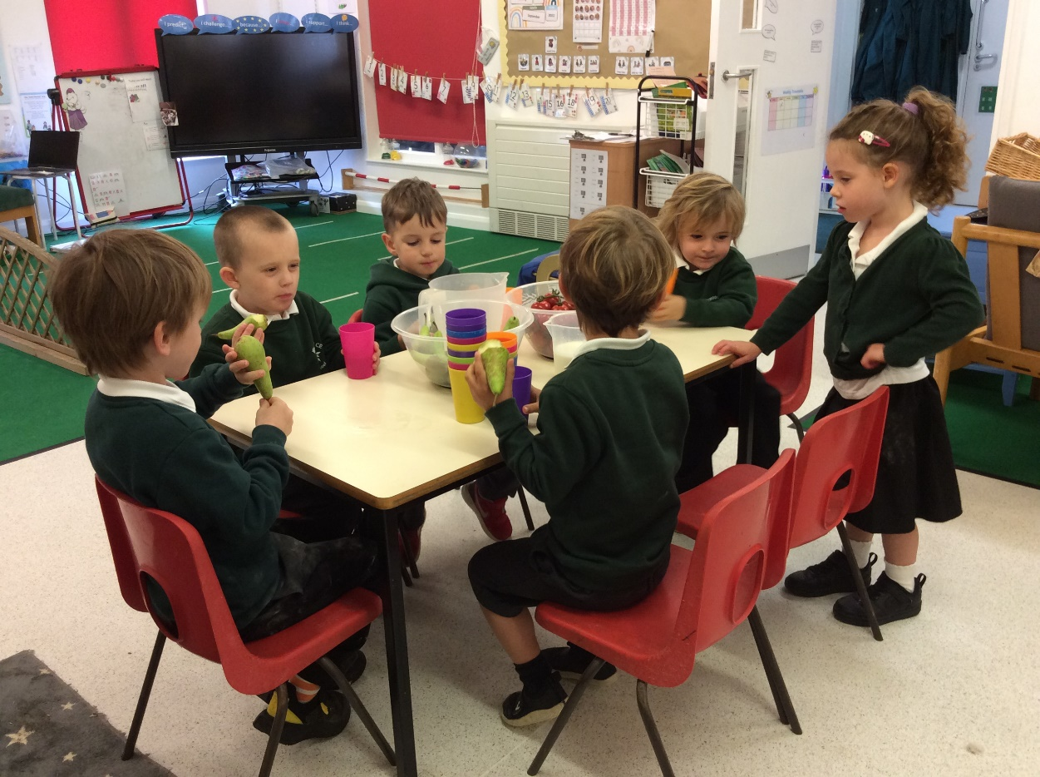
Supporting at home
Daily reading.
Name writing.
Letter formation.
Numbots.
Putting on coats and doing zips up independently.
Using cutlery.
Notes:
We recommend reading for about 10 minutes daily – this can be parent reading to child or vice versa.

Slide 14


Slide 15
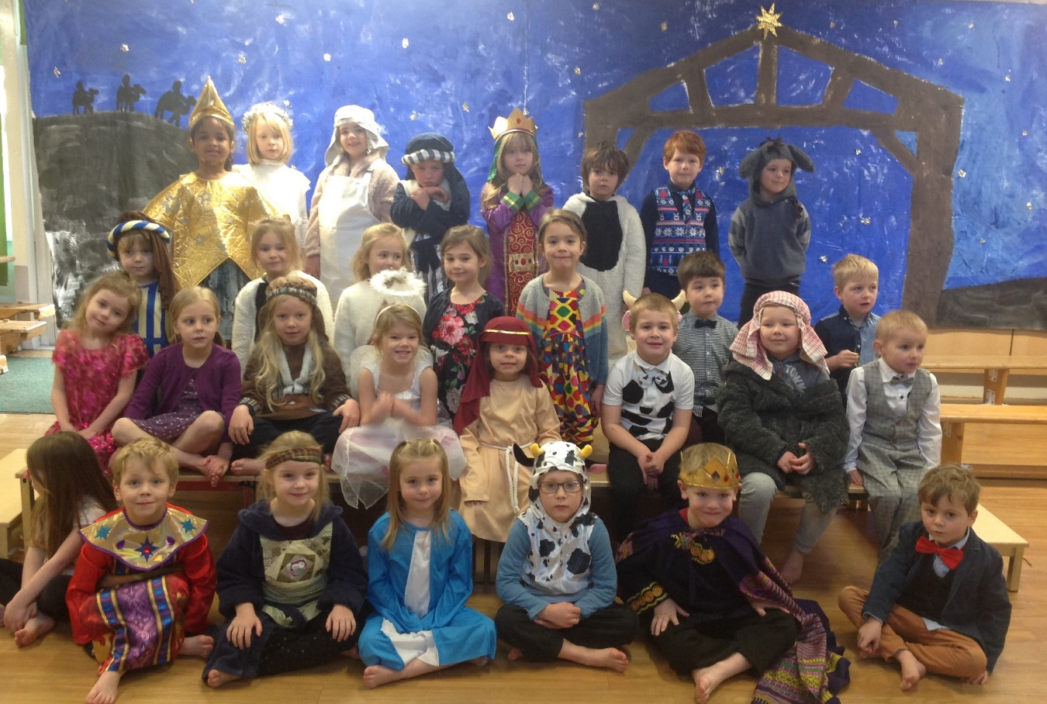
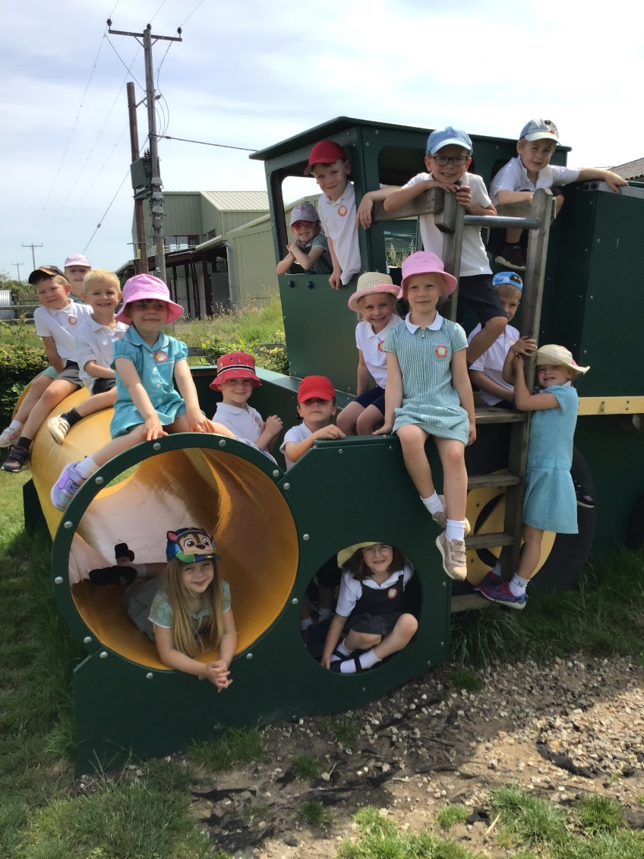
Special Events

Slide 16
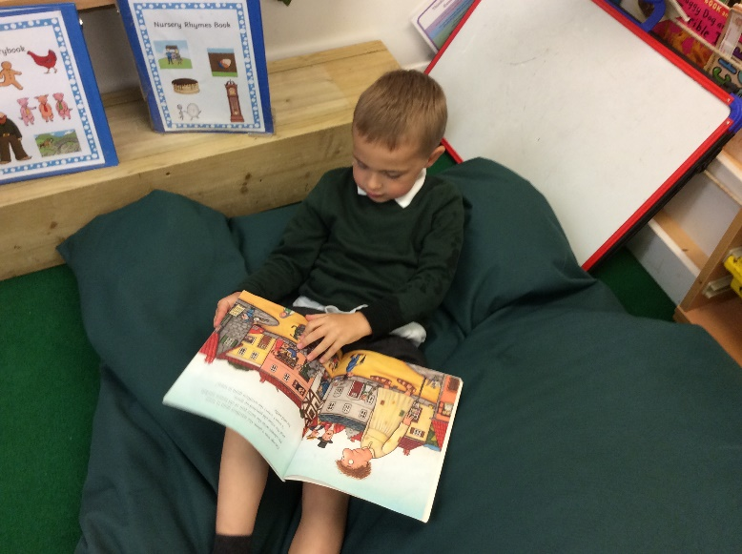
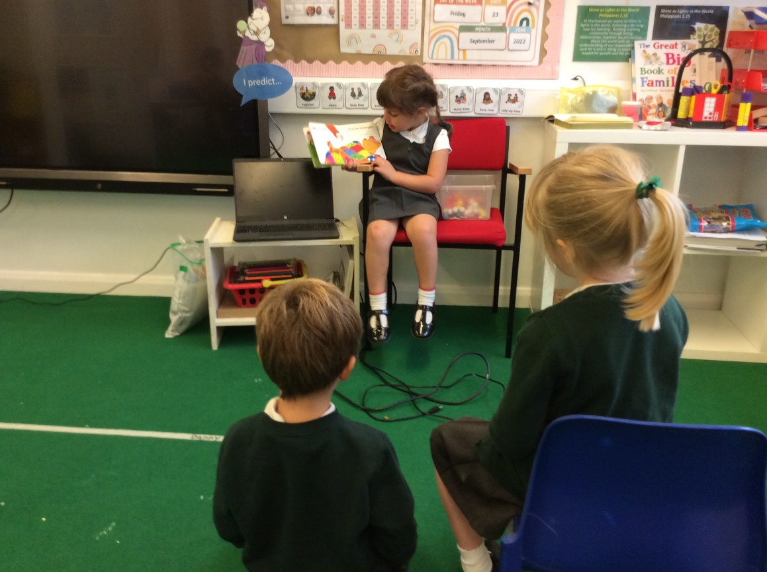
Other information:
Labels
Illness
Water bottles and lunchboxes
Key workers
Wow Moments
Home times
Coats and wellies
Birthday books
Invitations

Slide 17
Thank you for coming!
If you have any other questions or concerns throughout the year come and see us anytime.
Communication
After school.
Telephone messages via the school office.
Email via the school office.
School website
Newsletters
Seesaw
Parent Evenings
In the mornings
Notes:
KS

