Slide 1
Phonics
Notes:
Hello! Thank you so much for coming to our little talk. After speaking with several of you, we thought it might be quite useful to have this meeting where we can talk in a little more detail about what phonics is, how we teach it at Wychwood, and how you can support your child at home.

Slide 2
What is Phonics?
Teaching children to read and write
Individual sounds
Letter formation
Notes:
In the English language, there are 44 sounds and over 150 symbols to represent these sounds. It is one of the most complex alphabetic codes in the world. So to teach the children, we use Phonics. Phonics in its simplest term is a way of teaching children to read and write. This is done by learning to recognise individual letters and the sounds they make. These are then used to read words. Phonics also teaches children letter formation, how to write each letter. We teach how to form each letter with a little phrase e.g. to write the letter ‘a’, we teach the children to go ‘around the apple and down the leaf’. We will look at how to form and pronounce letters a little later in the presentation.
2

Slide 3
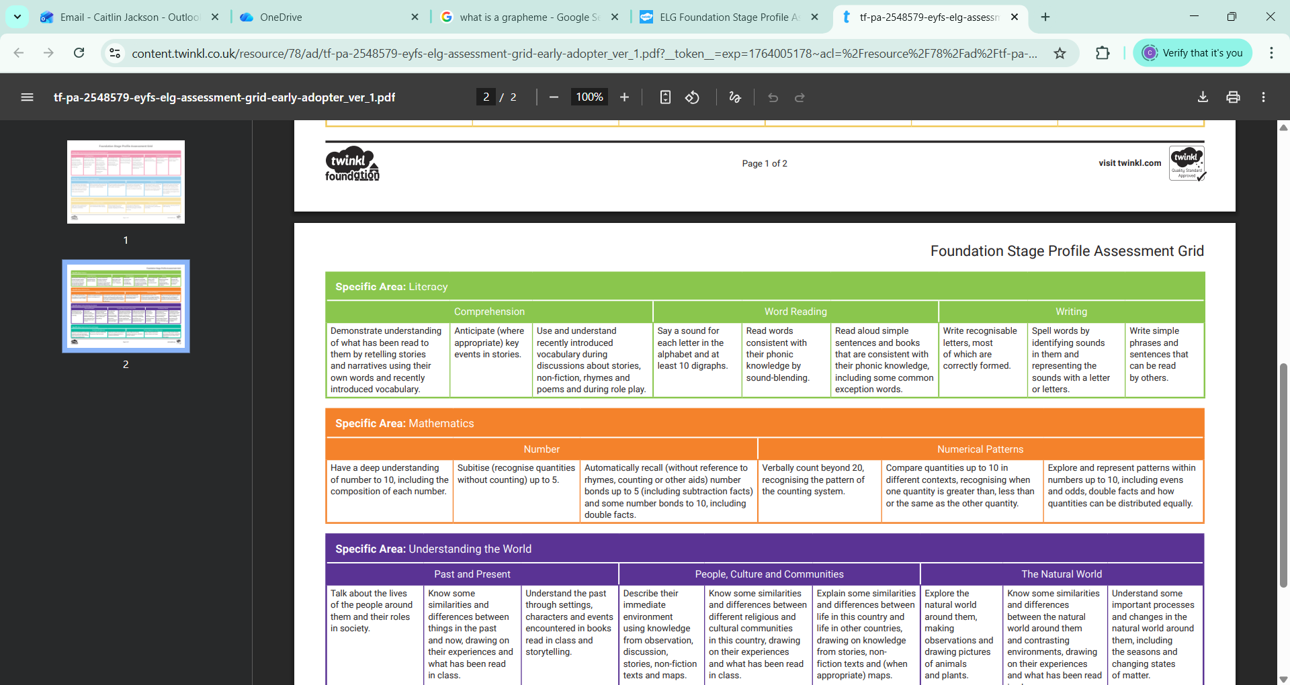
Notes:
At the end of Reception, we assess the children against the Early Learning Goals. In Literacy, there are 3 areas that we assess the children against. Comprehension, Word Reading and Writing. We will be working towards these goals across the year.

Slide 4
Key Terms
- Segmenting
- Blending
- Digraphs/trigraphs/special friends – e.g. ‘sh’ and ‘tch’
- Sight reading
- Green Words
Red Words e.g. ‘the’, ‘I’, ‘of’
Schwa
Fluency
Notes:
There are some key terms that we may use on seesaw when writing about your child’s reading or you may hear your child use at home.
Segmenting: saying the individual sounds in the words e.g. c-a-t. In RWI we call this ‘Fred Talk’.
Blending: saying the sounds together to make a word e.g. c-a-t are read together to form the word ‘cat’
Special friends: a term used in the RWI program. They refer to sounds that have more than one letter. A digraph has two letters that make one sound e.g. ‘sh’. A trigraph has three letters that make once sound e.g. ‘tch’.
Sight reading: the ability to recognise a whole word without having to segment it. It is really tricky for children to understand what they are reading when they are still sound out and blending each word. So we encourage children to learn and recognise words from sight so that they can understand what they are reading better.
Green Words: these are words that can be segmented and blended e.g. dog and bed
Red Words: In phonics, there are words which do not follow the ‘rules’ – they do not sound the way they are written e.g. ‘the’ sounded out would be ‘th-e’ but is not pronounced this way. We teach the children to sight read these words and tell them ‘you can’t ‘Fred’ a red’.
Schwa: This is when a sound is mispronounced by adding an ‘uh’ on the end e.g. ‘cuh’. If we tried to sound out a word and blend it with a schwa e.g. ‘cuh-a-tuh’ it sounds very different.
Fluency: the ability to read a text accurately (saying the words correctly), at an appropriate speed and with expression.

Slide 5
How do we teach Phonics at Wychwood?
Read Write Inc (RWI) – created by Ruth Miskin
Daily
Whole class and groups
Reading
If you would like to learn more about RWI, you can look at the website: https://www.ruthmiskin.com/phonics/about-read-write-inc-phonics/
Notes:
We follow the RWI phonics program. This is a systematic program which teaches children to read and write by linking sounds to letters. It meets the demands of the national curriculum and gives your child the best chance of success at learning to read and write.
We teach Phonics daily. On Mondays we have Whole Class Phonics where the children remain in their classes and recap previously learnt sounds.
Tuesday-Friday we have group phonics in which the children learn new sounds in smaller groups.
Once the children have learnt some sounds, we begin reading books in our phonics lessons. Paper copies of these books will be sent home at the end of each week. They should be returned to school the following week.

Slide 6
Reading
Once a week in school
Picture books
Blending Books
Word Books
Library and ‘Blue Trolley’ books
Notes:
We read with the children once a week. We begin by reading the previous week’s book. If necessary, we may send this book home to continue reading if your child is struggling with some of the sounds or is not yet able to sight read the words. Ideally, your child should be reading at least 80% of the words by sight before moving on to the next book.
Initially, children will have picture books which promote language development and key reading skills such as inferencing.
Next, the children will move onto blending books. These books correspond with the sounds the children have been learning and are used to practice blending.
Finally, the children will move on to worded books. These books also correspond with the sounds the children have been learning.
It is just as important for you to read to your child as it is for your child to read to you. Each week we will take your child to the library where they can choose a book to take home. These books should be in your child’s bookbag each Wednesday when they go to the library and can be changed. Your child will not be able to take a new library book home until the previous one is returned. We also encourage you to take a book from our blue trolley home to read with your child. The blue trolley is put by the sandpit at each drop off and collection and you may change these books whenever you like.
We will soon be starting to read books in our phonics lessons. Each week, we will send home paper copies of the book your child has been reading in their phonics group. This is for them to continue to practice their reading from at home. As we would have spent all week reading from this book, it would be good for you to encourage your child to try and sight read some of the words from this book.

Slide 7
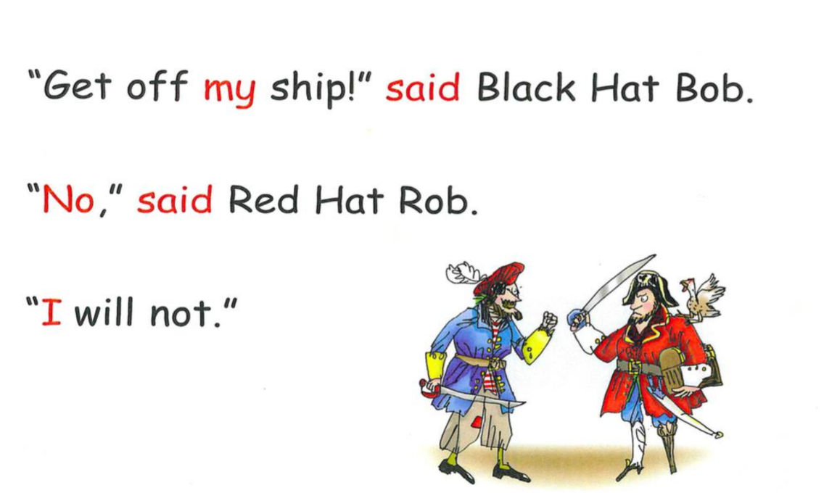
Notes:
This is an excerpt from one of the books that your child will read. The black words are ones that your child should be able to segment and blend because they contain sounds we have learnt. The red words (words that you can’t sound out) are in red. This helps the children clearly see that it is one of the words they have to know by sight.
Here is how your child will read when they first get the book:
If they mispronounce a sound, please point to the one they get wrong and ask them to look again.
Blending can be a little tricky, so if they are struggling, initially you could repeat the sounds to them. If they are still unable to hear the whole word, repeat the sounds, but a little closer together:
After a few reads, they should start recognising some of the words and sight reading, for example:
We always love to hear about how your child is getting on reading at home, so we really encourage you to write a little note, it does not have to be in great detail, about how they did on the Seesaw app. You could do this by commenting underneath our post about their read in school.

Slide 8
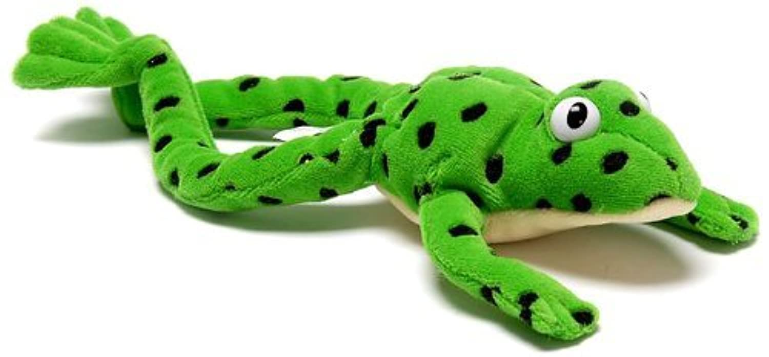
Writing and Spelling
Say the word
Fred Talk
Fred Fingers
Write it
Begin with simple CVC words then move on to sentences
Notes:
When writing and spelling words, we follow a specific sequence. First, we say the word. This is to help hear the sounds. Then we Fred Talk. Fred is the frog that is used in the RWI scheme to help the children segment and blend words e.g. the segmented word: ‘d-o-g’ is blended into ‘dog’. Then we use our Fred Fingers, we repeat the sounds and pinch our fingers to help us remember the sounds. Finally, we write it. If a child can’t remember what sound comes next, we encourage them to repeat the process. If your child is writing at home, we encourage you to follow this process too!
We begin teaching writing with letter formation. Then we begin to write CVC words and later in the year, progress to sentences.

Slide 9
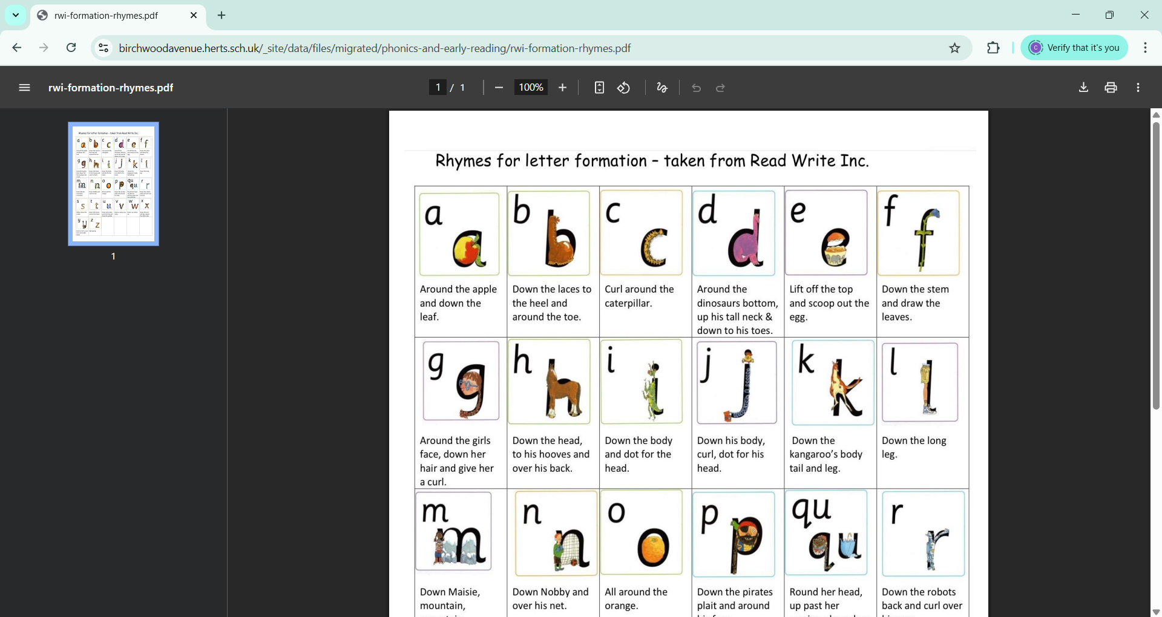
Notes:
We are going to practice how to say the sounds and look at how we teach each letter’s formation.

Slide 11
Notes:
RECORD ON PHONE AND EMAIL THEN UPLOAD TO PPT.

Slide 13


Slide 17
Notes:
We recommend reading for about 10 minutes daily – this can be parent reading to child or vice versa.

Slide 19
Notes:
RECORD ON PHONE AND EMAIL THEN UPLOAD TO PPT.

Slide 21
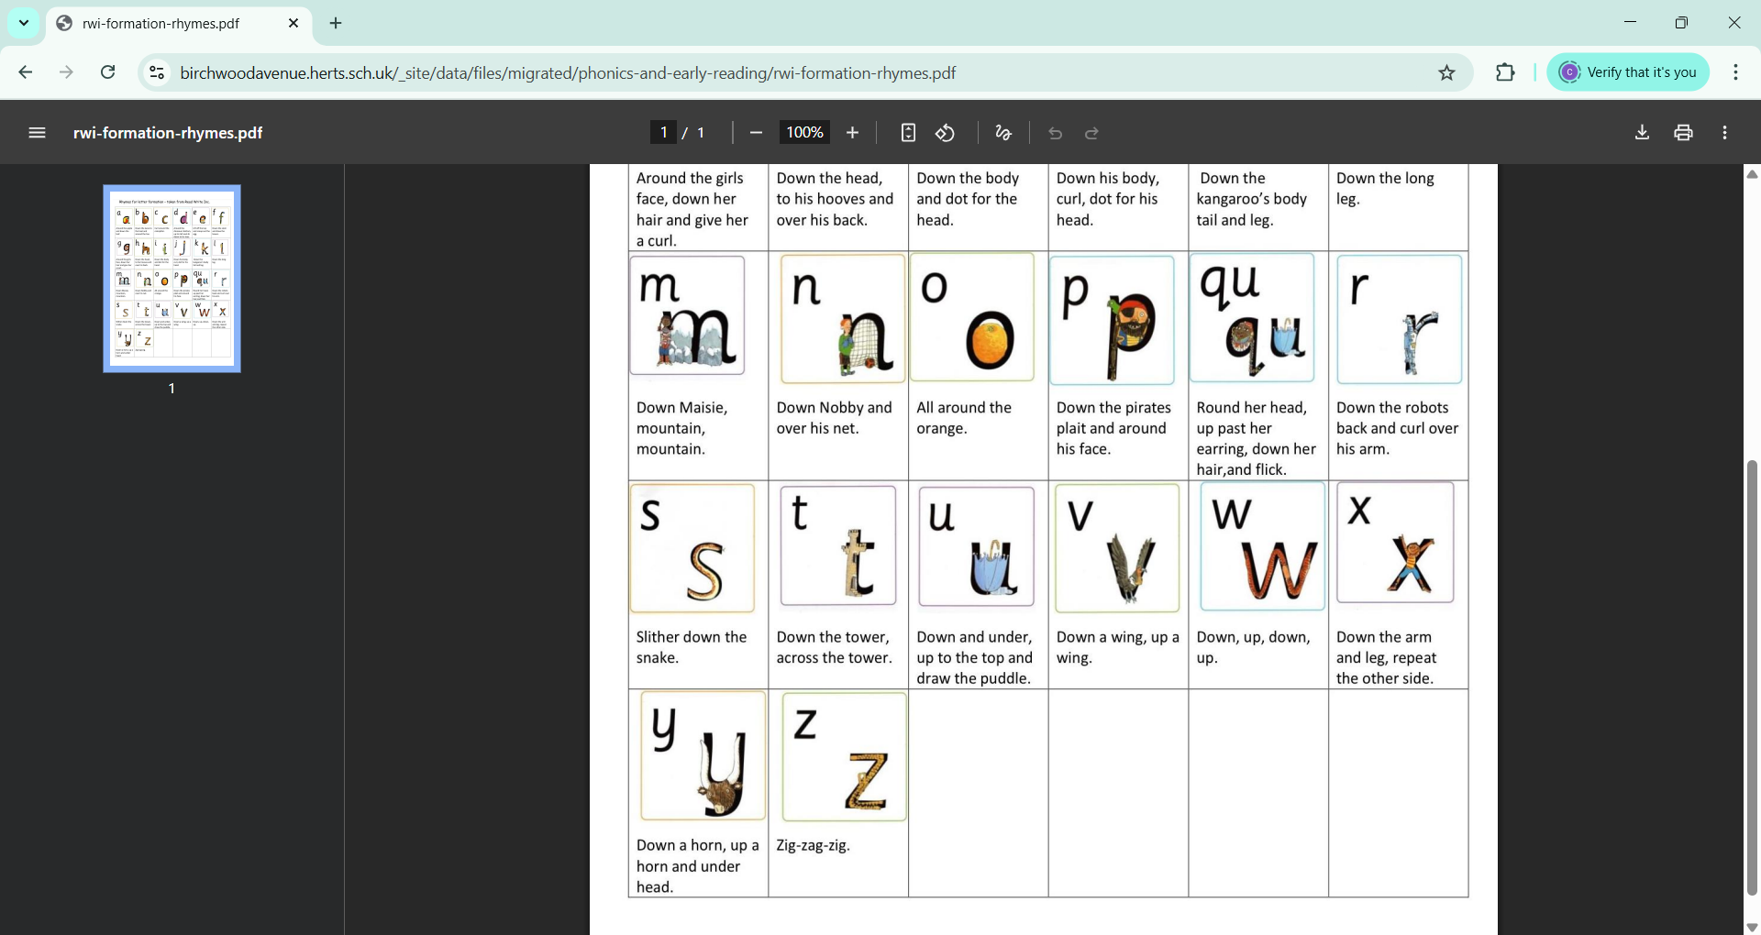

Slide 23
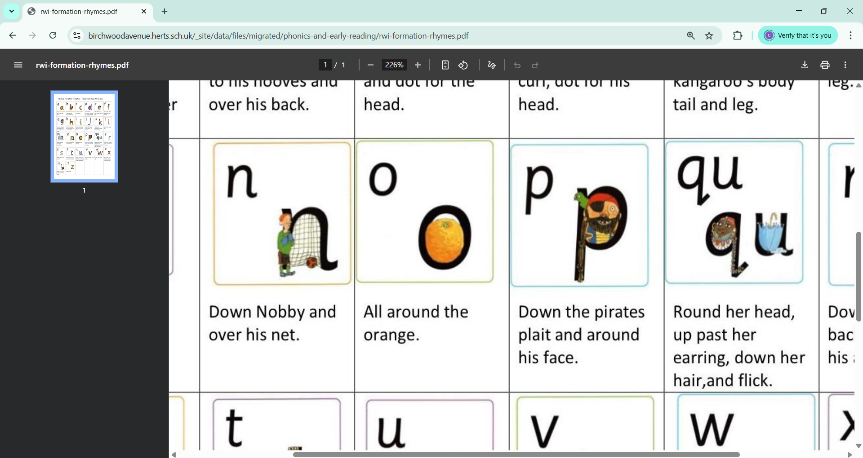

Slide 25
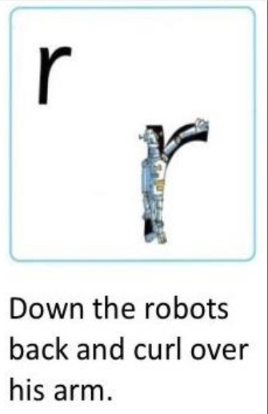

Slide 26
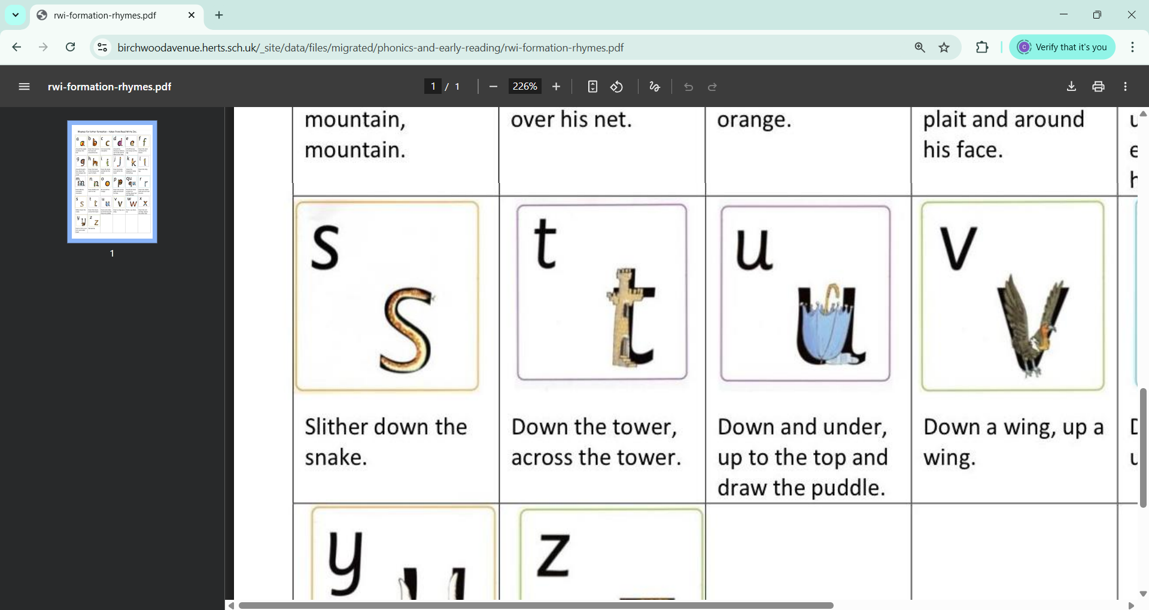

Slide 29
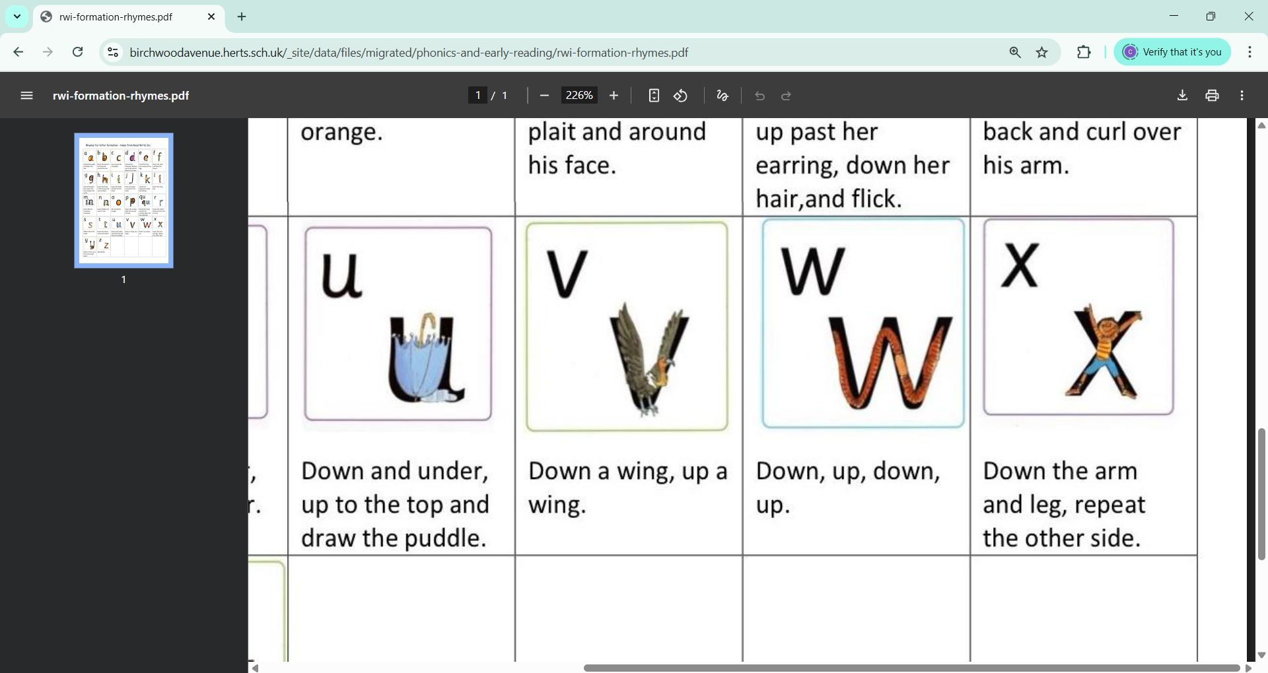

Slide 32
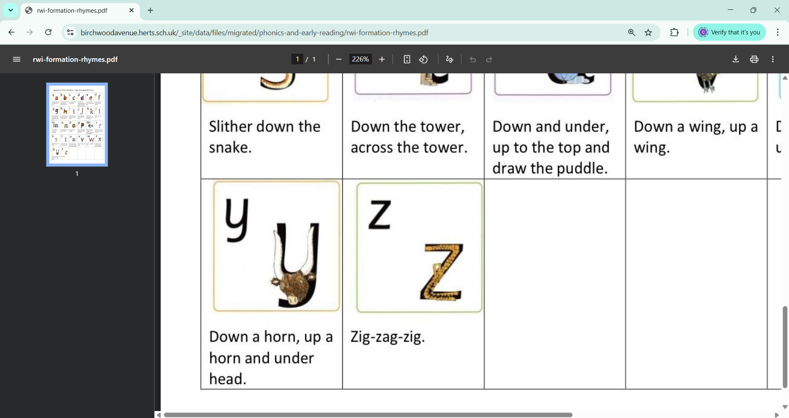

Slide 34
Notes:
We also have sounds that we call ‘special friends’. They have 2 letters that together make one sound.

Slide 35
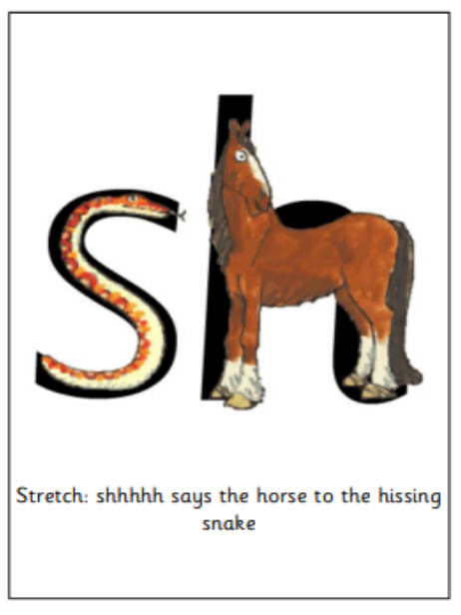

Slide 36
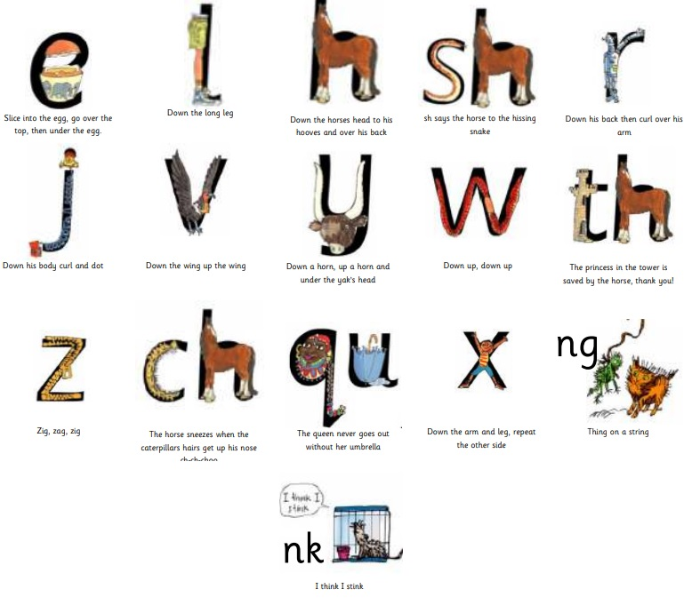

Slide 40

Notes:
At home, we strongly encourage you to read with your child for 10 minutes every day. Reading at home is meant to be easy. It is for consolidating what your child has been learning at school, not to learn new things. If they find it too difficult, they will not enjoy reading.
It is also just as important for you to read to your child. These books do not have to correspond with their reading level – you can read anything to them, the newspaper, pictures books e.g. Julia Donaldson, comic books etc. Audiobooks are also a really great way to inspire a love of reading in your child.

Slide 41
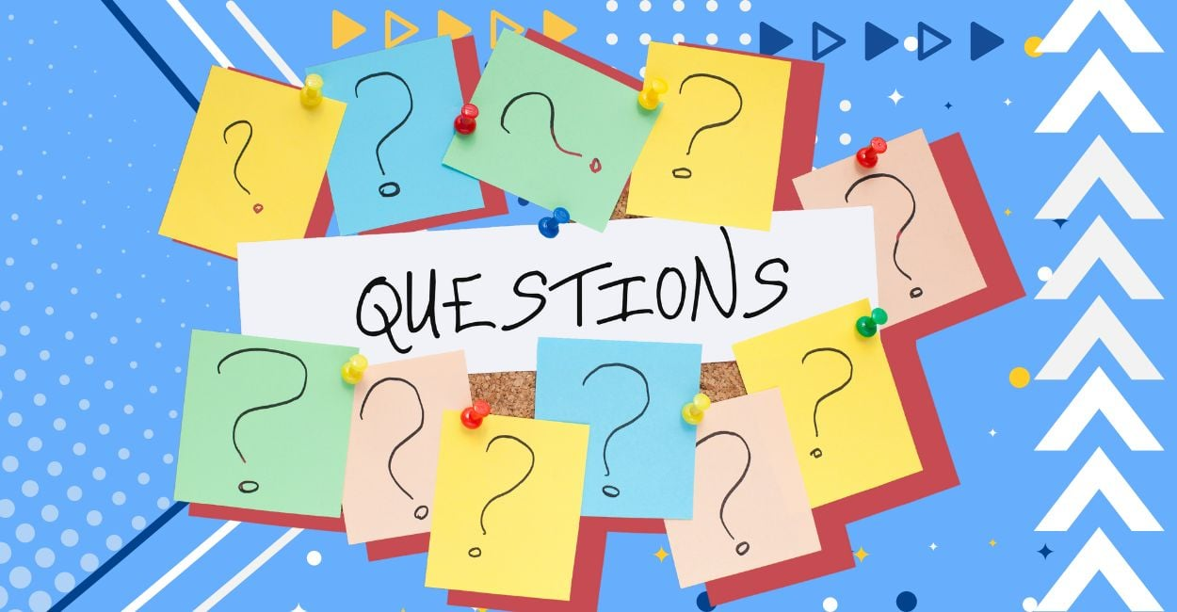
Notes:
If you have any questions about the information in this presentation, please do not hesitate to ask your child’s class teacher!

